Slide 1
IMAGE STORY TELLER
MUHAMED SADHIQ PV
MES20MCA032
PRODUCT OWNER: MR MUHAMMAD JABIR C

Slide 2
TABLE OF CONTENTS
Introduction
Modules
Methodology
Data Flow Diagram
Table Design
Developing Environment
Future Enhancements
Project Plan
User Stories
Product Backlog
Sprint Plans
Sprint Actual
Screenshots

Slide 3
INTRODUCTION
The aim of the project is to develop a software which will convert a text story into its corresponding image story. This software can represent a simple or even a big story with images corresponding to each sentence in the story. Each sentence of the given story is analyzed for its meaning and matching images are extracted from our dataset. The sentences are replaced by images which can convey the meaning of the text data, so that, the user obtains an image story line as an output for the text story line given as input. For finding which all words in each sentence make it meaningful, we make use of the NLTK module available in Python. At first, each word in the given story is tokenized using the tokenizer available in Python. The image story is designed in such a way that the images are represented in a gallery format. There is button which can be clicked to get the double corresponding to each sentence in the story. The sentence for each image, is also displayed below it, so that it can be understood in a better way
Currently to understand the inner meaning of an image people must either search or go to some experts for help. It is time consuming and sometimes images are not interpreted correctly. The project develop a software which will convert a text story into its corresponding image story. Each sentence of the given story is analyzed for its meaning and matching images are extracted from our dataset. The sentences are replaced by images which can convey the meaning of the text data, so that, the user obtains IMAGE STORY TELLER as an output for the text story line given as input. Thus users can understand the meaning of the image in a better way.

Slide 4
USER MODULES
MODULES
ADMIN
Login
Add Data Set(images)
View Users
View Feedbacks
USER
Registration
Login
Story Teller
Feedback

Slide 5
FUNCTIONAL MODULES
Text to Image Conversion
Text to Image Conversion is the next module.
This module involves:
Story to sentences
sentence comparison
tokenization
remove stop words from the string
stemming
create a vector containing keywords of both strings
pairewise similarity
Extract image from dataset with maximum similarity

Slide 6
METHODOLOGY
The aim of the project is to develop a software which will convert a text story into its corresponding image story.Each sentence of the given story is analyzed for its meaning and matching images are extracted from our datasets.The sentences are replaced by images which can convey the meaning of the text data, so that, the user obtains an image story line as an output for the text story line given as input. For finding which all words in each sentence make it meaningful, we make use of the NLTK module available in Python. The Natural Language Toolkit (NLTK) is a platform used for building Python programs that work with human language data for applying in statistical natural language processing (NLP). It contains text processing libraries for tokenization, parsing, classification, stemming, tagging and semantic reasoning.At first, we convert the story in to sentences. Stop words are available in abundance in any human language. By removing these words, we remove the low-level information from our text in order to give more focus to the important information.To remove stop words from a sentence, you can divide your text into words and then remove the word if it exits in the list of stop words provided by NLTK.Each word in the given story is tokenized using the tokenizer available in Python.Tokenization is essentially splitting a phrase, sentence, paragraph, or an entire text document into smaller units, such as individual words or terms. Each of these smaller units are called tokens.Stemming is a natural language processing technique that lowers inflection in words to their root forms.Stemming is a technique used to extract the base form of the words by removing affixes from them. ... For example, the stem of the words eating, eats, eaten is eat. Create a vector containing keywords of both strings.Pairwise cosine similarity is a metrix used to determine how similar two entities are irrespective of their size. The cosine similarity measures the similarity between vector lists by calculating the cosine angle between the two vector lists.Extract image from dataset with maximum similarity.

Slide 7
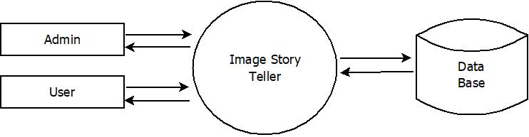
DATA FLOW DIAGRAM
LEVEL 0

Slide 8
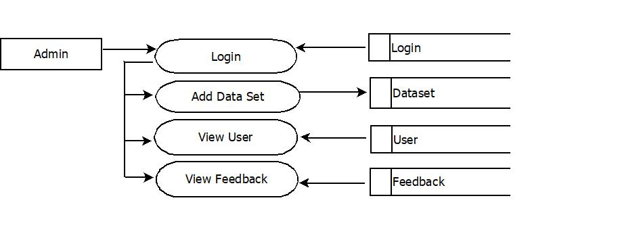
LEVEL 1.1

Slide 9
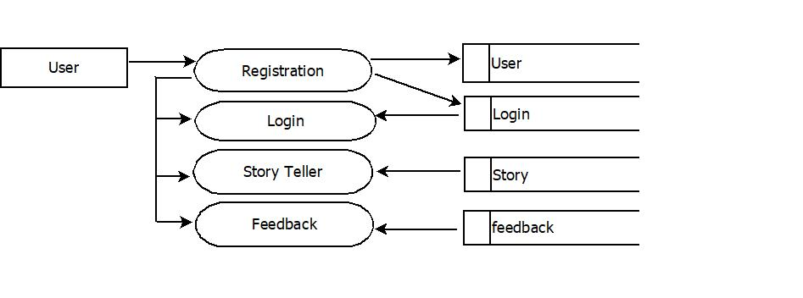
LEVEL 1.2

Slide 10
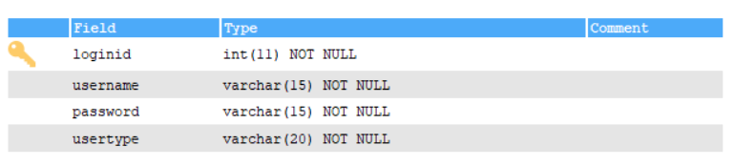
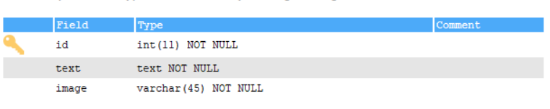
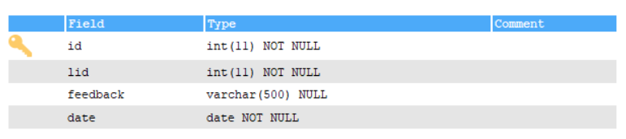
TABLE DESIGN
login
dataset
feedback

Slide 11
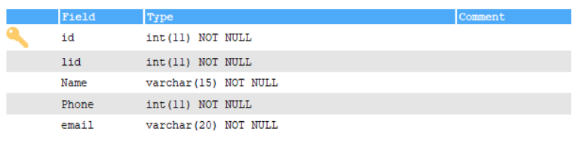
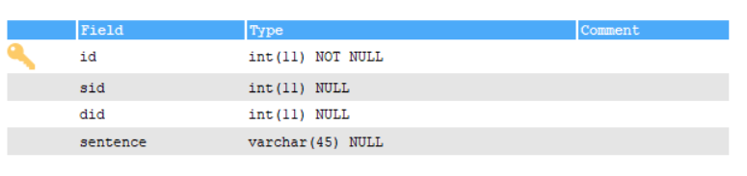
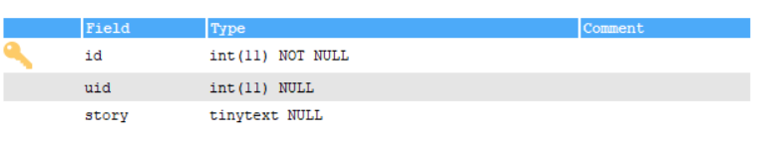
user
Image_story
story

Slide 12
DEVELOPING ENVIRONMENT
Processor : Intel Pentium IV
Monitor : Min. 14
RAM : 256 MB
Hard Disk : 80 GB
Keyboard : Standard 104 Keys
Modem : 56 Kbps
Mouse : Serial mouse
Operating System : Windows 8 or higher
Front End Tool : HTML, CSS, python
Back End Tool : MY SQL
IDE : Pycharm community, Android studio/eclipse
Web Browser : All new browsers

Slide 13
FUTURE ENHANCEMENTS
Now the project can only convert text to image . The user obtains an image story line as an output for the text story line given as input.
Now I have to add some functions ,
Convert image to text.
Produce audio output.
Preschool management.

Slide 14
PROJECT PLAN
User Story ID | Task Name | Start Date | End Date | Days | Status
1 | Sprint 1 | 26/12/2021 | 27/12/2021 | 2 | Completed
2 |  | 29/12/2021 | 31/12/2021 | 3 | Completed
3 |  | 03/12/2021 | 08/01/2022 | 5 | Completed
4 | Sprint 2 | 09/01/2022 | 16/01/2022 | 8 | Completed
5 |  | 18/01/2022 | 22/01/2022 | 5 | Completed
6 | Sprint 3 | 23/01/2022 | 27/01/2022 | 5 | Completed
7 |  | 30/01/2022 | 05/02/2022 | 7 | Completed
8 | Sprint 4 | 07/02/2022 | 10/01/2022 | 4 | Completed
9 |  | 17/02/2022 | 20/02/2022 | 4 | Completed

Slide 15
USER STORIES
UserStoryID | As a <type of user> | I want to | So that I can
1 | Admin | Login | Login successful with correct username and password
2 | Admin | View users | View registered users
3 | Admin | View feedback | View feedbacks send by users
4 | Admin | Add data set (images) | Retrieve images as output
5 | User | Registration | User’s can register with this app
6 | User | login | Login successful with correct Username and password
7 | User | Story teller | Input stories as sentence
8 | User | Feedback | Send feedback

Slide 16
PRODUCT BACKLOG
User Story ID | Priority <High/Medium/Low> | Size (Hours) | Sprint <#> | Status <Planned/In progress/Completed> | Release Date | Release Goal
1 | Medium | 2 | 1 | Completed | 27/12/2021 | Table design
2 | High | 3 |  | Completed | 31/12/2021 | Form design
3 | High | 5 |  | Completed | 08/01/2021 | Basic coding
4 | High | 5 | 2 | Completed | 16/01/2022 | Manage dataset
5 | Medium | 5 |  | Completed | 22/01/2022 | Text pre-processing
6 | High | 5 | 3 | Completed | 27/01/2022 | Text similarity matching
7 | Medium | 5 |  | Completed | 05/02/2022 | Image retrieval
8 | Medium | 5 | 4 | Completed | 10/01/2022 | Testing data
9 | High | 5 |  | Completed | 20/02/2022 | Output generation

Slide 17
SPRINT BACKLOG PLAN
Backlog Item | Status & completion date | Original estimate in hours | Day1 | Day2 | Day3 | Day4 | Day5 | Day6 | Day7 | Day8 | Day9 | Day10 | Day11 | Day12 | Day13 | Day14
User story #1,#2,#3,#4 |  | hrs | hrs | hrs | hrs | hrs | hrs | hrs | hrs | hrs | hrs | hrs | hrs | hrs | hrs | hrs
Table design | 27/12/2021 | 2 | 1 | 1 | 0 | 0 | 0 | 0 | 0 | 0 | 0 | 0 | 0 | 0 | 0 | 0
Form design | 31/12/2021 | 3 | 0 | 0 | 0 | 1 | 1 | 1 | 0 | 0 | 0 | 0 | 0 | 0 | 0 | 0
Coding | 08/01/2021 | 5 | 0 | 0 | 0 | 0 | 0 | 0 | 0 | 0 | 0 | 1 | 1 | 1 | 1 | 1
User story #5,#6,#7,#8
Manage dataset | 16/01/2022 | 6 | 2 | 1 | 0 | 1 | 0 | 1 | 0 | 1 | 0 | 0 | 0 | 0 | 0 | 0
Text pre-processing | 22/01/2022 | 6 | 0 | 0 | 0 | 0 | 0 | 0 | 0 | 0 | 0 | 2 | 1 | 1 | 1 | 1
Text similarity matching | 27/01/2022 | 6 | 2 | 1 | 1 | 1 | 1 | 0 | 0 | 0 | 0 | 0 | 0 | 0 | 0 | 0
Image retrieval | 05/02/2022 | 6 | 0 | 0 | 0 | 0 | 0 | 0 | 0 | 2 | 0 | 1 | 1 | 1 | 0 | 1
Testing data | 10/01/2022 | 6 | 2 | 1 | 1 | 1 | 1 | 0 | 0 | 0 | 0 | 0 | 0 | 0 | 0 | 0
User story #9
Output generation | 20/02/2022 | 6 | 0 | 0 | 0 | 0 | 0 | 0 | 0 | 0 | 0 | 2 | 1 | 1 | 1 | 1
Total |  | 46 | 7 | 4 | 2 | 4 | 3 | 2 | 0 | 3 | 0 | 6 | 4 | 4 | 3 | 4

Slide 18
SPRINT ACTUAL
Backlog Item | Status & completion date | Original estimate in hours | Day1 | Day2 | Day3 | Day4 | Day5 | Day6 | Day7 | Day8 | Day9 | Day10 | Day11 | Day12 | Day13 | Day14
User story #1,#2,#3,#4 |  | hrs | hrs | hrs | hrs | hrs | hrs | hrs | hrs | hrs | hrs | hrs | hrs | hrs | hrs | hrs
Table design | 27/12/2021 | 2 | 1 | 1 | 0 | 0 | 0 | 0 | 0 | 0 | 0 | 0 | 0 | 0 | 0 | 0
Form design | 31/12/2021 | 3 | 0 | 0 | 0 | 1 | 1 | 1 | 0 | 0 | 0 | 0 | 0 | 0 | 0 | 0
Coding | 08/01/2021 | 5 | 0 | 0 | 0 | 0 | 0 | 0 | 0 | 0 | 0 | 1 | 1 | 1 | 1 | 1
User story #5,#6,#7,#8
Manage dataset | 16/01/2022 | 6 | 2 | 1 | 0 | 1 | 0 | 1 | 0 | 1 | 0 | 0 | 0 | 0 | 0 | 0
Text pre-processing | 22/01/2022 | 6 | 0 | 0 | 0 | 0 | 0 | 0 | 0 | 0 | 0 | 2 | 1 | 1 | 1 | 1
Text similarity matching | 27/01/2022 | 6 | 2 | 1 | 1 | 1 | 1 | 0 | 0 | 0 | 0 | 0 | 0 | 0 | 0 | 0
Image retrieval | 05/02/2022 | 6 | 0 | 0 | 0 | 0 | 0 | 0 | 0 | 2 | 0 | 1 | 1 | 1 | 0 | 1
Testing data | 10/01/2022 | 6 | 2 | 1 | 1 | 1 | 1 | 0 | 0 | 0 | 0 | 0 | 0 | 0 | 0 | 0
User story #9
Output generation | 20/02/2022 | 6 | 0 | 0 | 0 | 0 | 0 | 0 | 0 | 0 | 0 | 2 | 1 | 1 | 1 | 1
Total |  | 46 | 7 | 4 | 2 | 4 | 3 | 2 | 0 | 3 | 0 | 6 | 4 | 4 | 3 | 4
Backlog Item | Status & date | Original estimate in hours | Day1 | Day2 | Day3 | Day4 | Day5 | Day6 | Day7 | Day8 | Day9 | Day10 | Day11 | Day12 | Day13 | Day14
User story #1,#2,#3,#4 |  | hrs | hrs | hrs | hrs | hrs | hrs | hrs | hrs | hrs | hrs | hrs | hrs | hrs | hrs | hrs
Table design | 28/12/2021 | 3 | 1 | 1 | 0 | 0 | 0 | 0 | 0 | 0 | 0 | 0 | 0 | 0 | 0 | 0
Form design | 31/12/2021 | 2 | 0 | 0 | 0 | 1 | 1 | 1 | 0 | 0 | 0 | 0 | 0 | 0 | 0 | 0
Coding | 08/01/2021 | 5 | 0 | 0 | 0 | 0 | 0 | 0 | 0 | 0 | 0 | 1 | 1 | 1 | 1 | 1
User story #5,#6,#7,#8
Manage products details
Rating management
User history mapping
Recommendation
Testing data
User story #9
Output generation
Total |  | 10 | 1 | 1 | 0 | 1 | 1 | 1 | 0 | 0 | 0 | 1 | 1 | 1 | 1 | 1

Slide 19
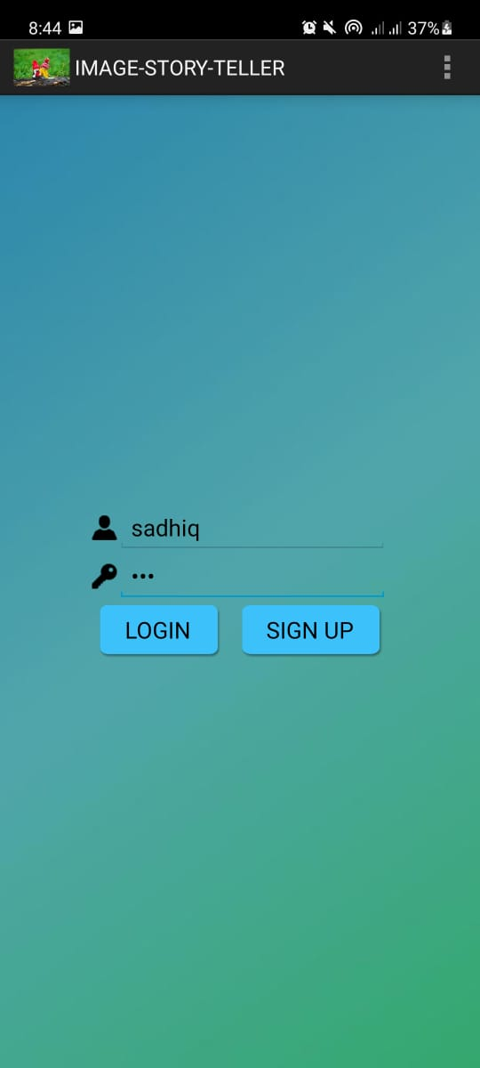
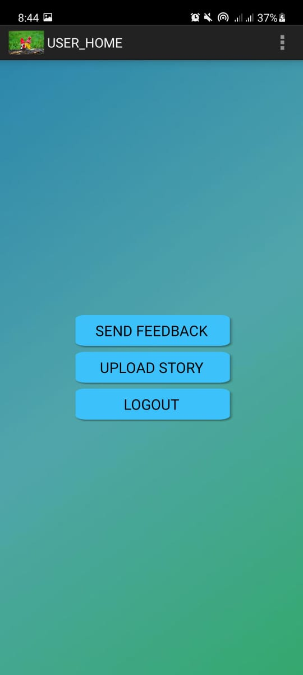
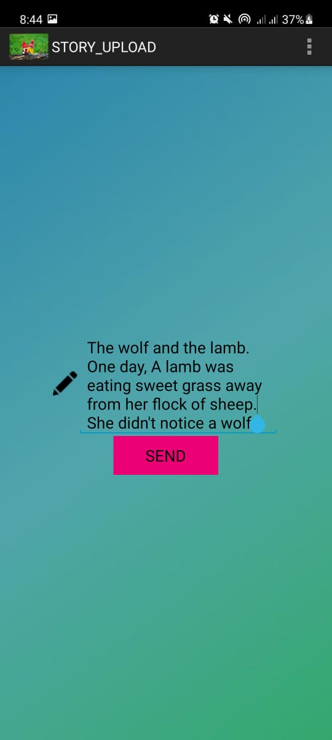
SCREENSHOTS

Slide 20
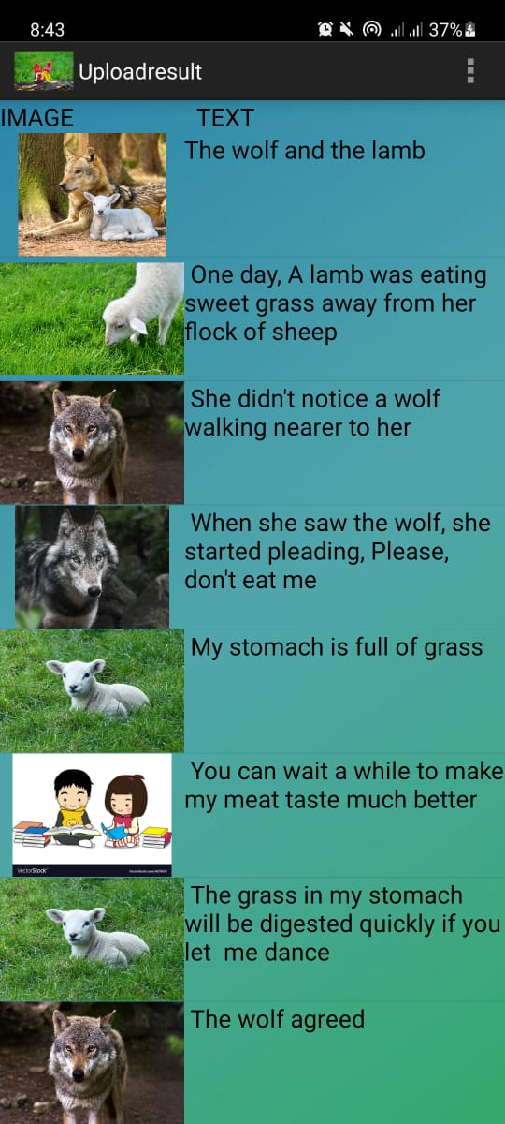
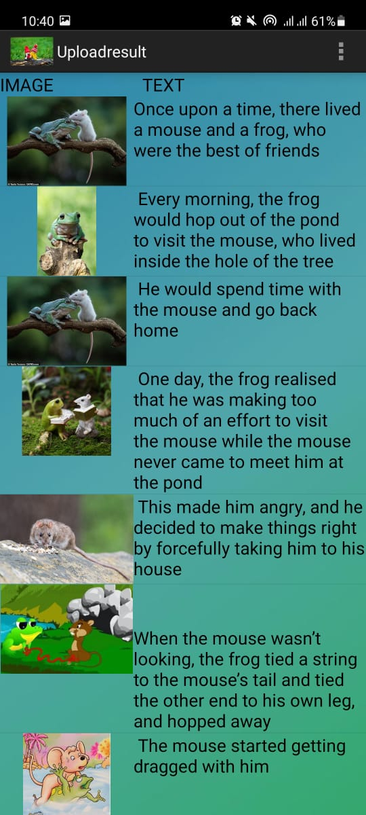
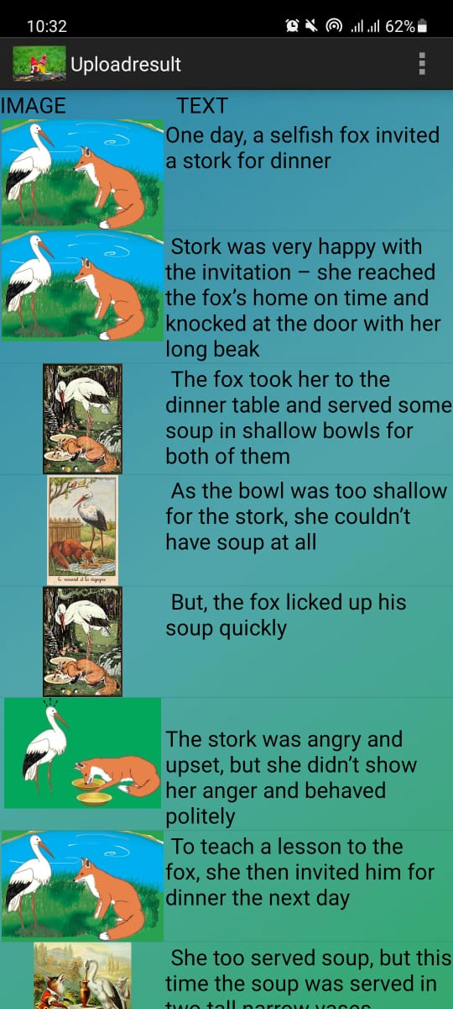

Slide 21
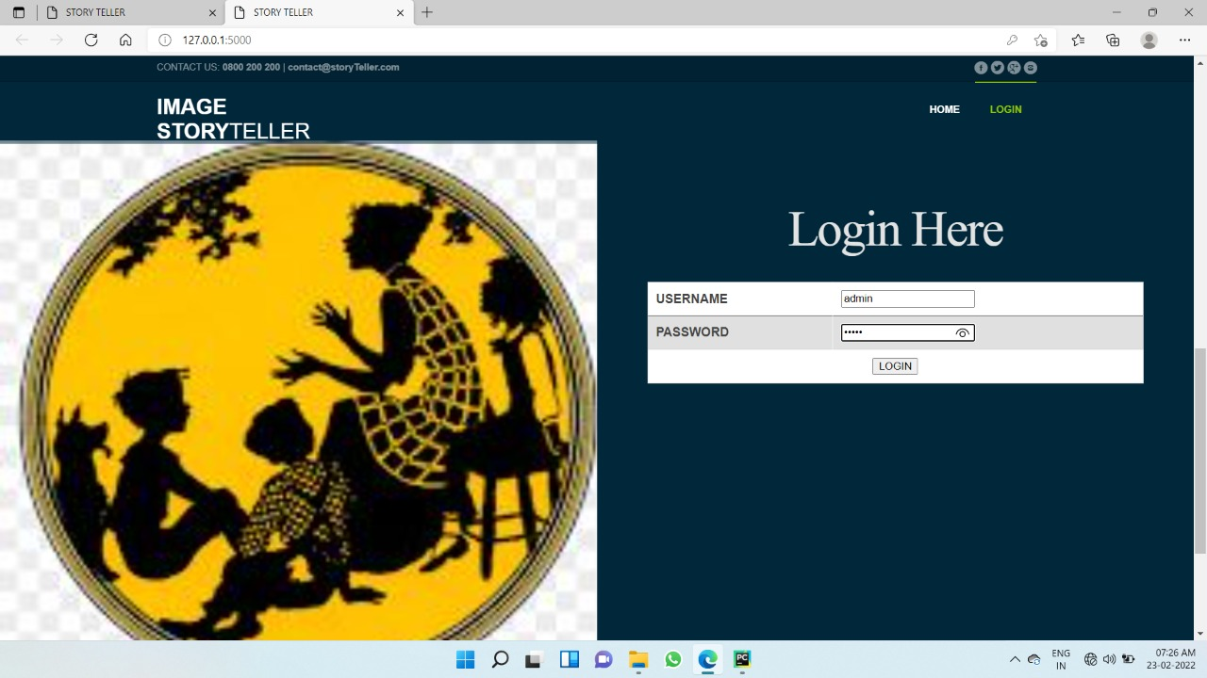
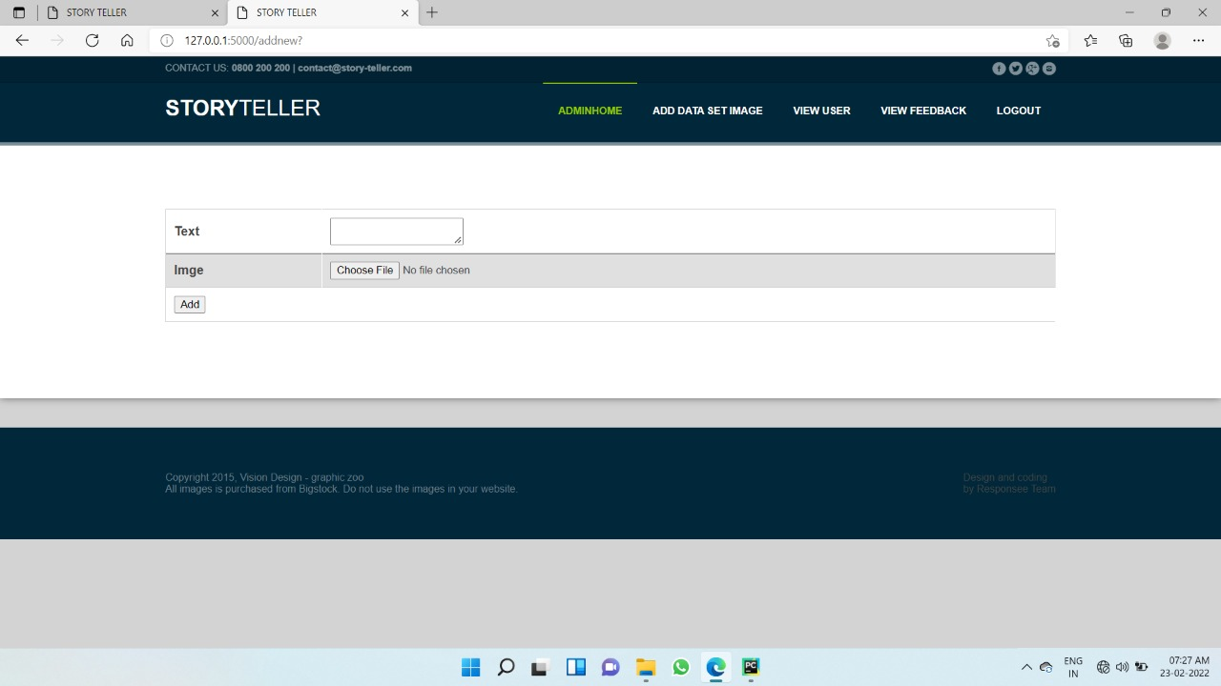
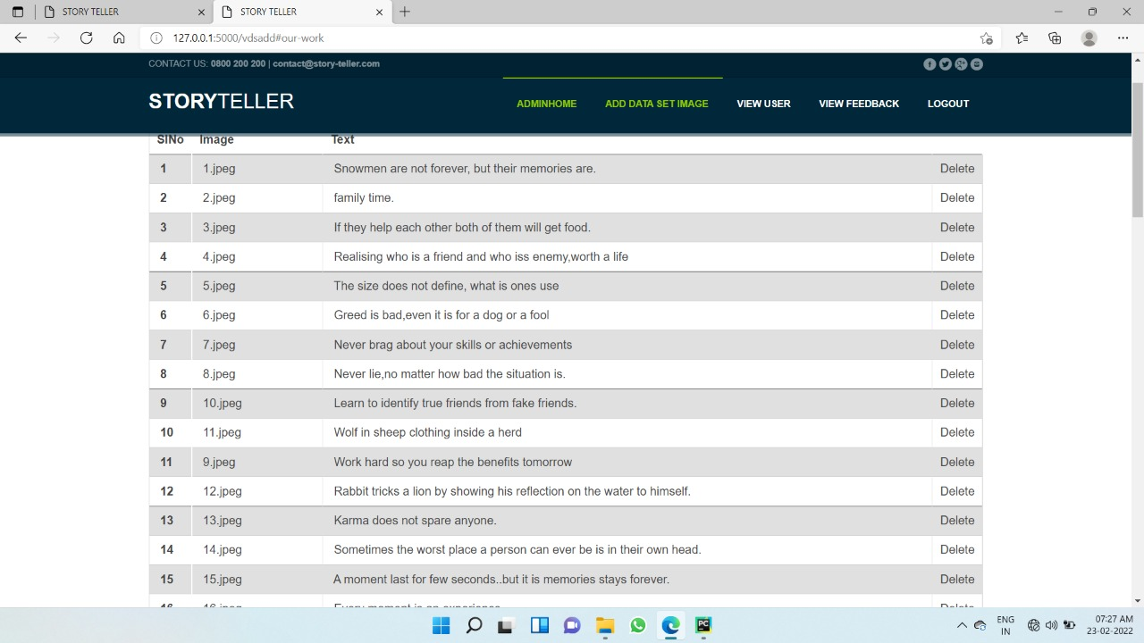
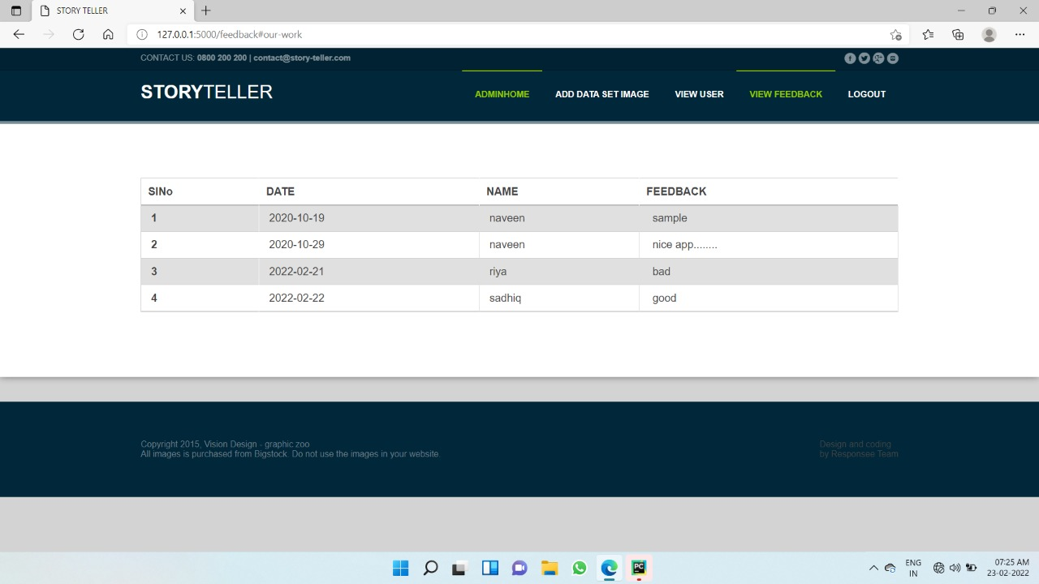

Slide 22
THANK YOU

